Slide 1
Car Rent Program
Presentation by Viktor Kavaldzhiev, Bozhidar Dimitor, Kaloyan Dimov, Stoicho Dimitrov

Slide 2
Purpose of our project
Our purpose of the project is to create program for purchasing and renting cars. Through our project it will be way more easier for people to decide which car they want to rent, because there is easier accessibility of information for every each car and which cars are able for rent. The goal is to achieve perfection of our program and help many other companies.

Slide 3
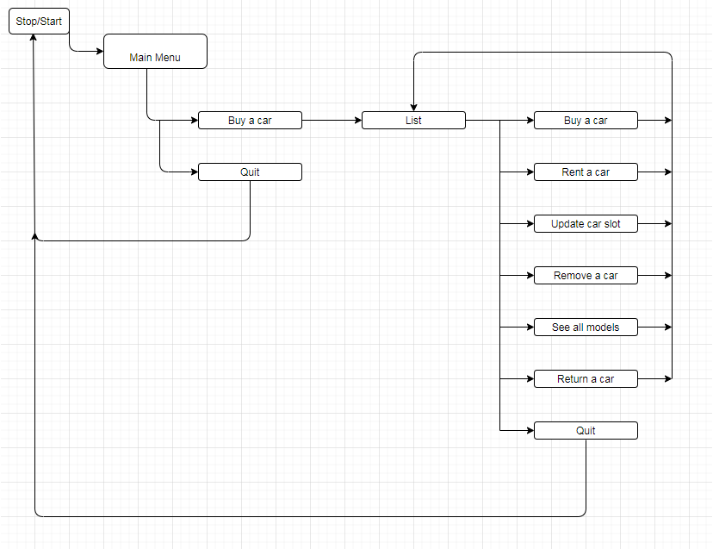
Diagram of our project

Slide 4
Table of data functions in the program
Functions | Description | Arguments | Return Value
Create() | Adds a new car to the list of cars | CAR* cars,int& size,string plateNum,string model,string colorWay, string manufactureDate,int kilometers,char condition,float score,float prize | “Bool” function, returns true or false, depending on the success of the function
Update() | There are four different update functions available, each designed to change a particular field in the structure | CAR* cars, int/char/string/float value , int i, string stat | “Bool” function, returns true or false, depending on the success of the function
Remove() | Removes a car from the car list | CAR* cars, int& size, int index | Empty function
Return() | Changes the field “rent” to its current state | CAR* cars, int index | “Bool” function, returns true or false, depending on the success of the function
Rent() | Changes the field “rent” to its current state | CAR* cars, int index | “Bool” function, returns true or false, depending on the success of the function

Slide 5
Developers
Manager – Bozhidar Dimitrov, bddimitrov18@codingburgas.bg, 9”v”
Participants – Viktor Kavaldzhiev, vgkavaldzhiev18@codingburgas.bg , 9”v” Stoicho Chakarov,
stchakarov18@codingburgas.bg, 9”g” Kaloyan Dimov, KDDdimov@codingburgas.bg, 9”b”

Slide 6



Used programs
We used :
Github - sharing files, so everyone can work on the them
Visual studio - making the program
C++ - The programing language we used for our program

Slide 7
Thanks for the attention!

